Slide 1
Async rust

Slide 2
Why Async
Async allows us to wait the results of operations without blocking a thread.
So we might want to use it for:
I/O operations
Web services
Notes:
So to start, for anyone in the room that’s not familiar with async, what we are trying to do with it is without launching a huge amount of threads we want to scale the amount of operations we are doing, usually the amount of operations we are doing on external things that might take time to process. For instance if my web service is waiting on reading a file that it’s going to serve to a client, I want to be able to service as many other clients as I can in the meantime while I wait for that file I/O to happen.
You can think of it as a task scheduler. However with the caveat that we want the ability for this to run in a single threaded environment without falling over. This is one of the reasons that it can be troublesome and in worst case you end out with deadlocks in your async code.

Slide 3
Async across languages
Simplified; the following languages are like rust:
Python (coroutine)
Javascript (Promise)
C# (Task)
Async is syntactic sugar for functions that create and return a Future.
Notes:
So in simple terms if you have worked with async in any of these languages you probably won’t have too much trouble getting into rust async.
Async is syntactic sugar for functions that create and return a Future type in rust, and in these languages they return their respective types.
So, in python couritines, javascript promises, c# tasks.
These types are not particularly special but they must be handled in special ways. In Rust the future needs to be either awaited in an async context, or you must ask the runtime to resolve it.
To understand what that means we need to understand…

Slide 4
Function COlouring
Brief primer on function colouring:
Every function has a colour (It either has an async keyword or it doesn’t; red or blue)
You can only call a red function from within another red function
So my entire program is async now…?
Notes:
Function colouring is an abstract term but it is often used to describe how async works.
Every function has a colour, red or blue, if it’s async it’s a red function.
In a bunch of languages you can only really call red from red. There are ways around it in a bunch too, but in general it’s going to be more painfull to call red from blue.
.. And you could create dependencies that end up meaning the functions you are calling from that are meant to still be blue aren’t completely blue anymore.

Slide 5
Function COlouring
Ok, but I only care about Rust.
Well in Rust to call an async function:
Your function call itself becomes async; or
You can use functions like spawn_blocking() to retrieve the resulting value
This is perhaps where Rust is slightly different from the JS & Python approach.
C# (optional colouring), Go, Lua and Ruby all have async without this colouring.
Notes:
But anyway, specifically talking rust.. Well you can change your function to async, or you can use a function like spawn_blocking() to get that result in a synchronous function, that is passing it to the runtime to resolve and getting the result back.
Mixing of these contexts seems fairly easy to me, I haven’t had nearly as many problems in Rust as I have in C#. But, there is possibility to deadlock here or have bad performance. if you are using spawn_blocking to call a crate that has used block_on() to provide an async version of their synchronous crate you can end up in deadlock, because it is now limited by the number of threads. A core part of async is that you want to be able to have a large number of concurrent agents without increasing the number of threads.

Slide 6

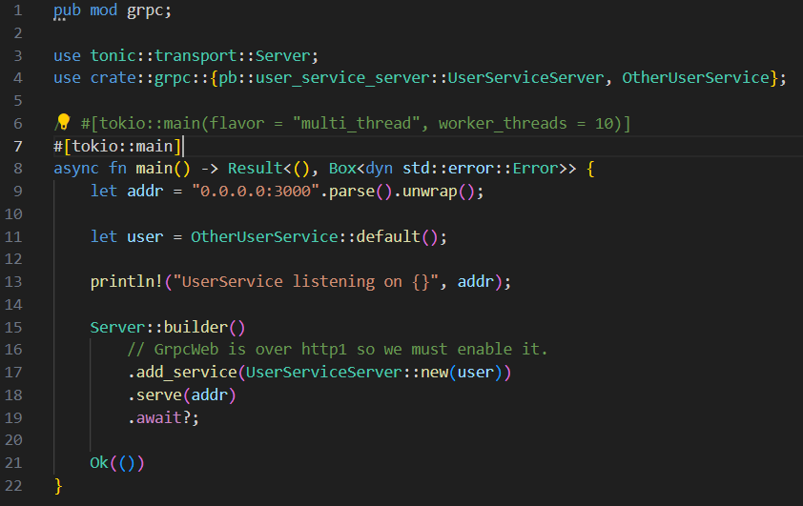
ASYNC Runtimes
You can’t mix and match really easily.
Some libraries require you use the same runtime as them.
Runtimes:
Tokio – Most widely used
Async-std – Dead
Smol – 1000 LOC async-runtime
Embassy – Embedded async
Glommio – For I/O bound, uses io_uring
Notes:
So how do I start in async rust? Well tokio is how you start probably unless you have a specific requirement that you are trying to build against.
Here is an example of a web server, the tokio::main attribute is providing the main function with some magic to make it async, and then you are jumping right into having a stack of purely async and you can more or less write your code as you would in a synchronous way, except you will have a lot more .awaits in order to retrieve the value of the futures instead of invoking it synchronously, but it reads in a procedural way. If everything is working as expected you will be writing your functions basically like you expect them to function synchronously and letting the runtime do the work.

Slide 7
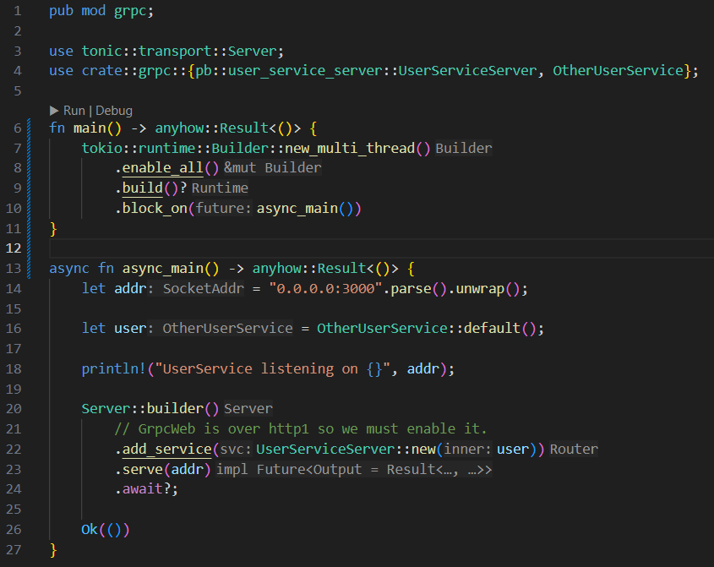
Going Deeper
The trait is basically just building the runtime and launching threads.
But didn’t you say we were doing async to get away from threads?
Notes:
So let’s presume you all know how to write your own code, and let’s focus on the runtime. So if we dig a little deeper, the async tokio attribute we were using is just convenience, through that attribute we can actually specify pretty much everything we care about, but if you want to dive into some builder stuff, you can customize the runtime like this. The main function is synchronous again, but it just configures and launches into the async_main function. You can customize things such as drivers it’s using, amount of threads, i/o events per tick, a fair amount of control.
But aren’t we using it to try and get away from threads?

Slide 8
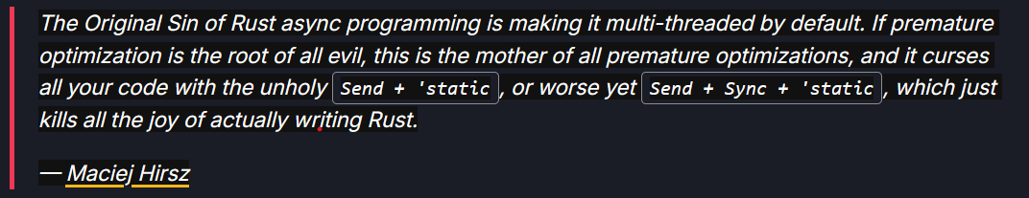
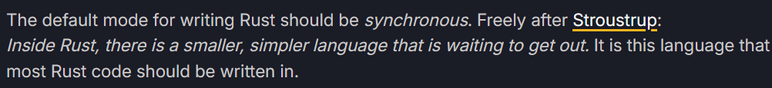
ASYNC IS THE FUTURE
[Ref]: https://corrode.dev/blog/async/
Notes:
Well.. Yeah.. The main problem is that it bakes it in by default. Then you have async, but you also have threading.

Slide 9
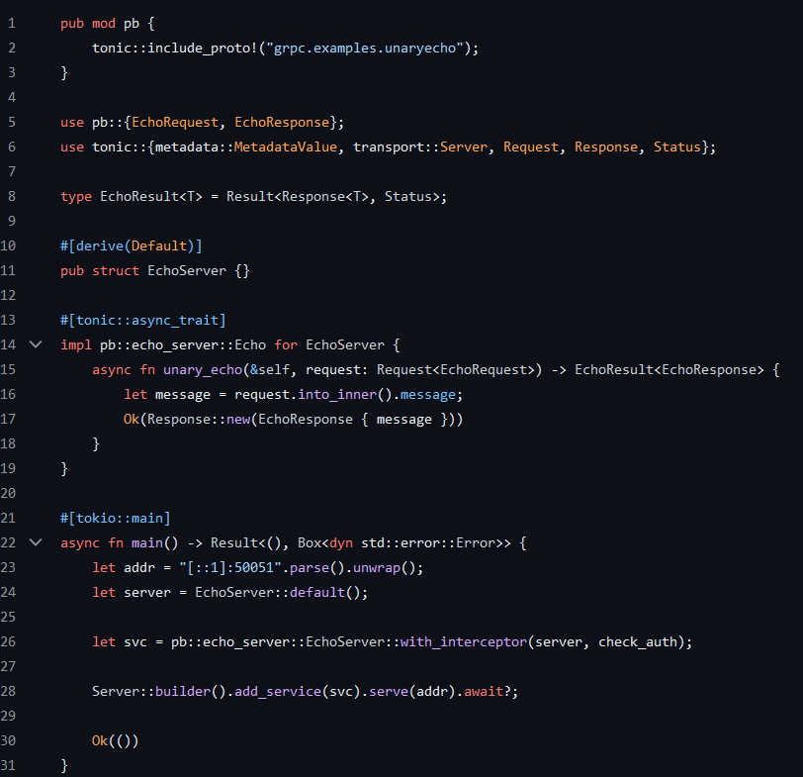
Arguments against
Use sparingly
Use it where you need to
Don’t discount a threaded approach instead: Linux systems scale to tens of thousands of threads.
Notes:
Um, so what do we do? Well my advice is use it where you need to, feel comfortable in it. If a library you are using has been written async-first, then use async. In my example I am using tonic to serve a grpc web server, and if you go and look at the code examples for tonic it’s all async. So… I might think about just building it async from the get-go.

Slide 10
Ok, Let’s go async
We decide to write it async
We know how to launch the runtime
Now what do I need to know?
Notes:
Ok, so we decide to write it async, we have covered a bit about how to launch into async and get a runtime. Now what is it doing… and what gotchas do I have to know about.

Slide 11
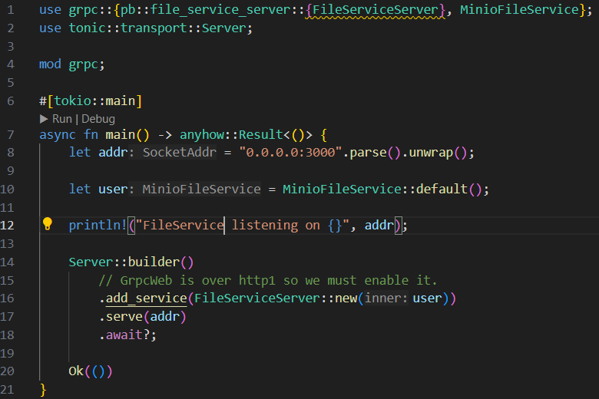
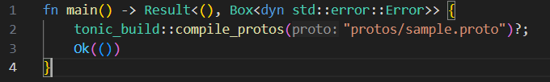
Example
main.rs
Let’s make a service.
It’s called FileService.
Here’s our runtime creation.
build.rs
Notes:
Right, so we have our runtime that we saw before, then I am creating a grpc service called FileService. If you’re not familiar, we have an extra build step here in the build.rs that is going to generate us a bunch of boilerplate code from the sample.proto file. Sample.proto is a grpc spec and details what this service looks like. I don’t want to get into it too deeply in terms of explaining grpc though. Suffice to say, we have a web service that has an endpoint that is going to stream back the contents of a file. The struct that I have implementing this I have named MinioFileService, minio is an object store database, so you can roughly guess where it’s getting the file from. Now minio publishes it’s own crate, and I have previously worked with it so I knew that it was an async, and so because tonic and minio here are async, it would be a pain in the butt if I didn’t implement it with async.

Slide 12

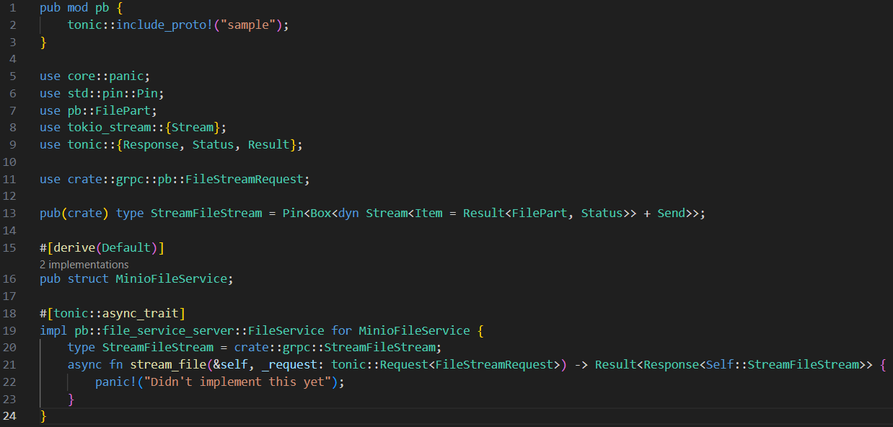
Looking at the service
Notes:
And this is my grpc.rs, at the top we include the auto-generate code, then we define the StreamFileStream type which describes our response. Then for MinioFileService we implement a function called stream_file(); All it does though, is just panic at the moment. So what I want to do is drill down on what an implementation of this function might look like in async.

Slide 13
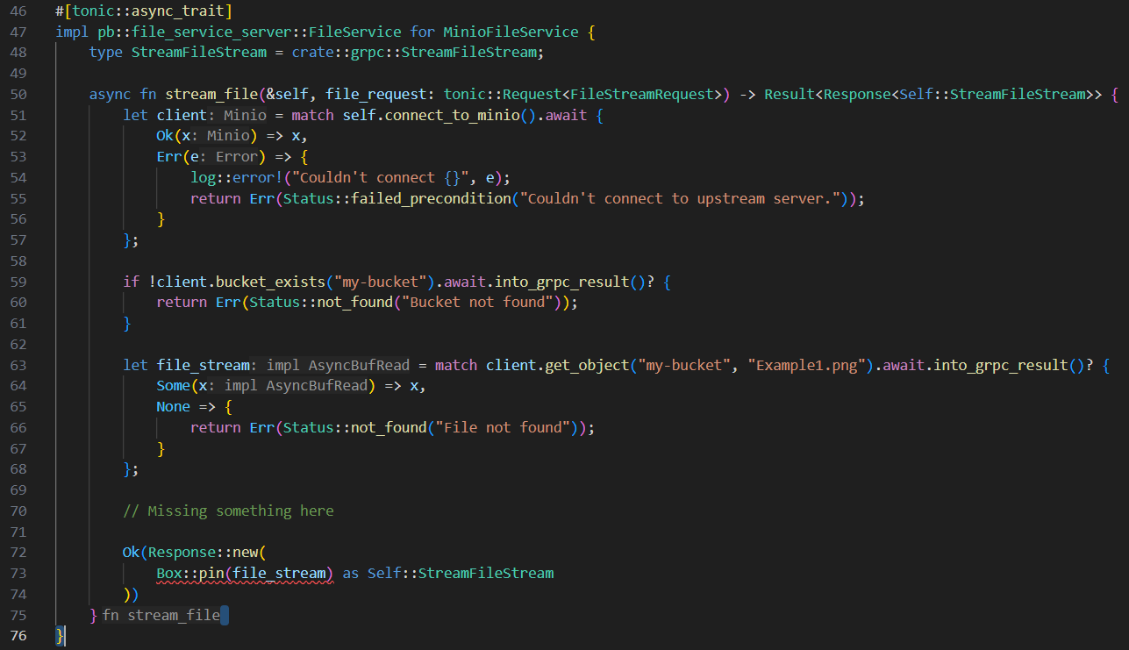
Deeper into minioR
Notes:
So we start with doing a connection, code for this is above this slide a little but basically all it does is create a connection in the api. We can see that this almost looks like regular rust, we are just kind of going through it as if we were calling it synchronously. Connect, if it fails return an error result. I have started to abstract away the grpc_result return values as we have a minio return type from their API. In the event of an error checking if a bucket_exists it will cascade that Status up. If it doesn’t exist but the actual call worked we return with an error.
But now we get to the part that I want to explore which is the streaming. So in a synchronous environment maybe I can pull this from a vector, wrap it in a cursor something like this. Maybe even do a include_file! Macro and bake it in. But we start to get a bit more down to the requirements from the async library as we go deeper into this example.
So in this example notice line 63, we go and do a get_object, now this is returning a trait AsyncBufRead. This is a stream of file contents.
And the return value of our function should be a stream of file parts as well. But slightly different because it’s in the grpc format.
So theres some mutation we will have to do. But first lets take a quick look at these traits.

Slide 14
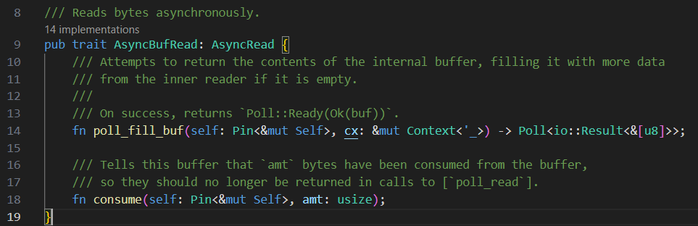
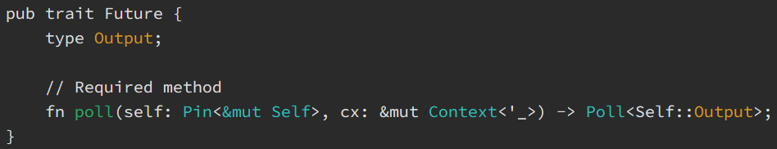
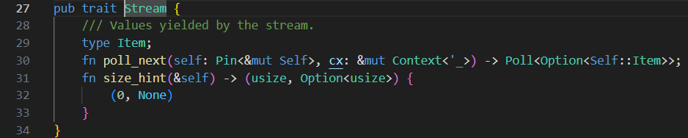
Related TRaits
AsyncBufRead is providing a file piece by piece.
Looks similar to Future.
Because it’s from tokio io it’s different again to something like Stream from futures-core.
Notes:
AsyncBufRead is defined here at the start, it has a poll_fill_buf function, this function essentially expects the runtime to be calling poll() on it repeatedly, until it returns Poll::Ready with an empty buffer to indicate theres nothing more to read. The get_object is giving us this back and we should use this to read our file piece by piece. Whether or not in actual behaviour it comes back to a single read or wraps multiple http requests we shouldn’t really care much. We have an abstraction and we are going to use it naively for now.
The second trait here is Future, this is the trait that underpins the entirety of async land, it has a poll function that is expected to be called repeatedly too. The poll function takes a mutable self, and a context var which is used to wake up the future when it becomes ready to continue execution, overall the poll function is just checking the state and if the pol returns Pending we can assume that the executor / runtime (they are terms used interchangeably) will call poll again, and again until it returns an Error, or the Ready state.
And finally the last trait is the stream trait, which is what we need to pass back out of our grpc function, this is essentially the response to the web request.
A note on Pinning: It is sometimes useful to be able to rely upon a certain value not being able to move, in the sense that its address in memory cannot change, and that’s what the Pin wrapper does here, I won’t go into it too deeply but it is used everywhere in async as a future must be pinned before it’s polled. This is getting down into the weeds though.

Slide 15
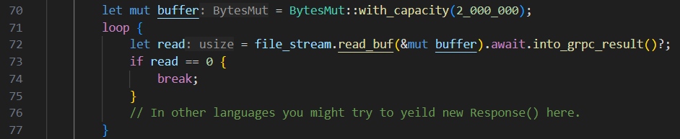
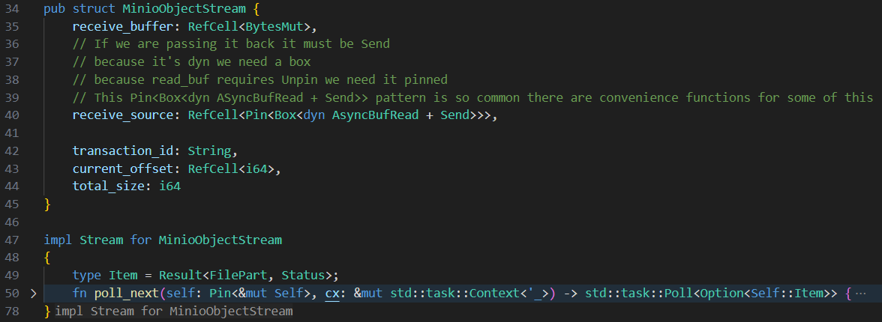
Deeper into async
In most languages there is a concept of yielding a result in a stream as you go through it asynchronously.
Or If there were something like an into_iter() to map things
But let’s take the dark path…
Notes:
So now I have shown you boilerplate and I have explained the traits associated. Now I will explain my problem. So one fine sunny day I am working on a backend service and my boss comes up to me and says, we really need this grpc service to stream a file from minio. So… I burst into tears, but once the crying stops.. I uh think about the problem. So step one, I need to grab a file from minio, sick, we already do that. Then I would have a stream of a file, and I need to convert that into a stream of grpc responses, however I have the constraint that grpc max message size is 4MB, which is not true for what’s being streamed at me from minio. So I need some type of interface that takes in the file and streams it, and because I love pain and the size of the file could be several gig so we don’t want to store it locally.
Ok, so in a synchronous context, maybe I take the file and read a 4mb portion and then I go and send that guy when I get my buffer full, and repeat until I send it all. In async rust because we also have threads to work with we could do something like this too, spawn off a thread for each request, we are probably going to hit bandwidth issues before we hit thread issues I guess. But you see, I have heard of this new thing called async rust, and my resume needs padding out with buzzwords.
So in async how would I take an async stream of data coming in, buffer a set amount, mutate it into a grpc message.. And we need to give back a Stream trait because that’s what tonic wants us to give it, so we must conform with how it’s going to be calling us to do it.
Now in some languages there this concept of a yield operator, and as you go through an iteration you can yield a result and in that way you kind of have many return values from the one function. In rust we do have this option via the async-stream crate, which despite being obviously named I took a long time before I found. So I am going to take you down the dark path of async internals, so what happens if I want to implement the Stream interface and because I am already in the poll function I can’t call await, at least according to random people on reddit. So let’s see what this looks like when I have to call poll from inside my poll..

Slide 16
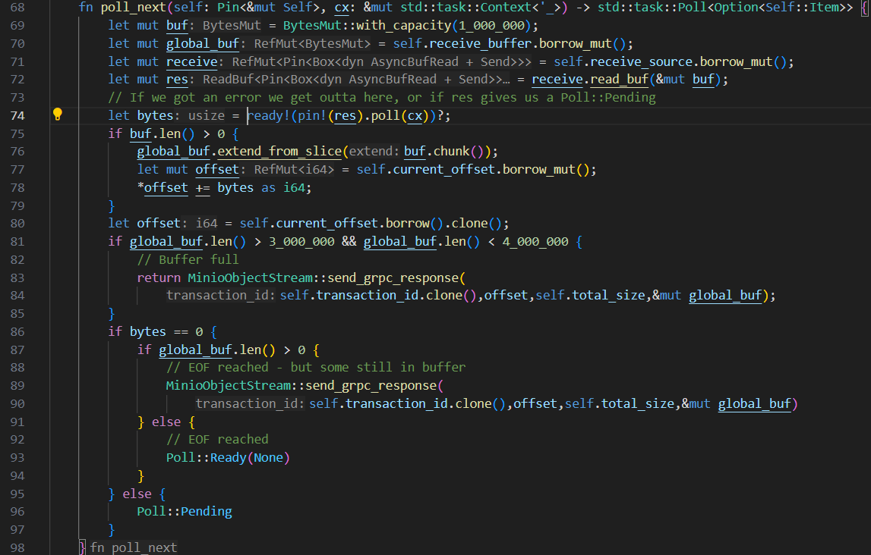
Urgh..
Notes:
Here we have an implementation of Stream. When poll_next gets called it calls read_buf but does not call await on it. Instead the future is polled. This poll should give us back bytes written to our buffer receive on line 52. If it returns 0 either there is nothing to read or our buffer is full, so we do some logic based on if it has space remaining in the buffer. If theres nothing in the buffer aka full space left, and we got 0 then it’s the end of file. Everytime we get called we call poll on that read buf and try and get more data, if we hit full usage of the buffer, or if bytes == 0 we are going to dump the buffer to a grpc message and send it.
Theres some pretty terrible logic to not fully fill the buffer here because I was having some fun trying to get everything working cause I left it to the last minute, but basically the reads coming back from minio are not really full all the time, so I might get back 64k or 1mb, and the BytesMut will increase in size as required even though I kinda want to limit it, there are ways to do that I have an example of a nicer implementation coming up, but thought I would talk through these states.
Now I also want to point out, this depends on the library a great deal, but this is a worst case. Basically your library might implement a way to mutate as you read this out. Alternatively you could launch a thread that reads from the async buffer and pipes it into a channel when it gets to 4MB.
But, summarizing some of this. We kind of read the buffer, do a ready macro the ready macro bails out if the Future we are polling against is Pending. If not we have some data that’s been read to our buf by the receive’s poll function. So then we copy it to a global buffer, because this function is going to be called many times. If we get to the point where our global buffer is full, we fire off a grpc response, we return that as a Poll::Ready event, and then finally once the end of the file is reached with fire off a Poll::Ready event with an Option of None to tell tonic to stop the stream.

Slide 17
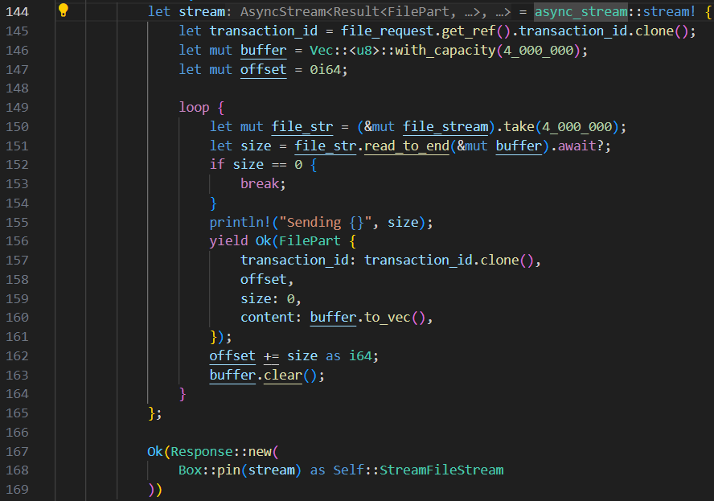
OR.. If you’re boring
Notes:
Ok so we _can_ do it simpler if we want, and really we should always want. But there is a certain amount of learning that is cool to do by boiling it down to the basics. So remember how I said most languages use yield, well, here is a slightly easier on the eyes implementation. More correct too.

Slide 18
Want more reading?
State machines and assembly: https://www.eventhelix.com/rust/rust-to-assembly-async-await/
Async in 2024: https://smallcultfollowing.com/babysteps/blog/2024/01/03/async-rust-2024/
Function Colouring: https://morestina.net/blog/1686/rust-async-is-colored
Async rust runtimes: https://corrode.dev/blog/async/
https://itnext.io/asyncwrite-and-a-tale-of-four-implementations-e63aef8397f7
Notes:
And here is some more reading or some of the resources that were really useful when trying to boil down my async understanding into something potentially transferrable to other people.

Slide 19
Now some tests…
Notes:
Now I’m going to show you the code running and a few async tests and we can dissect my questionable code.

